Slide 1
Structural Design Patterns
Instructor: Mehroze Khan

Slide 2
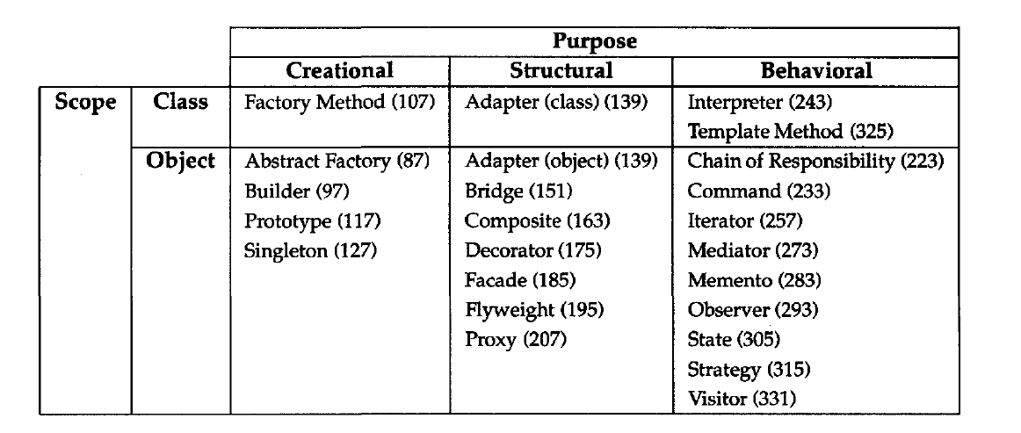
Structural Design Patterns
Structural design patterns explain how to assemble objects and classes into larger structures, while keeping these structures flexible and efficient.
Structural class patterns use inheritance to compose interfaces or implementations.

Slide 3
Composite Pattern

Slide 4
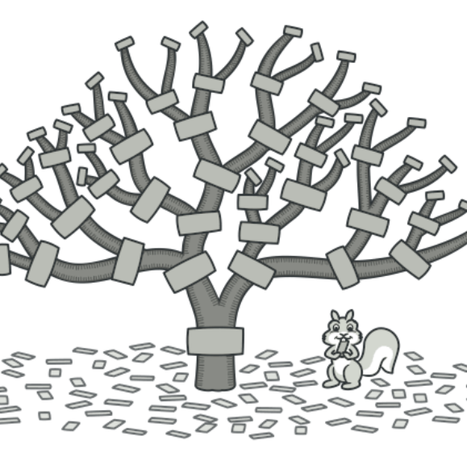
Composite Design Pattern
Also Known as: Object Tree
Intent:
Composite is a structural design pattern that lets you compose objects into tree structures and then work with these structures as if they were individual objects.

Slide 5
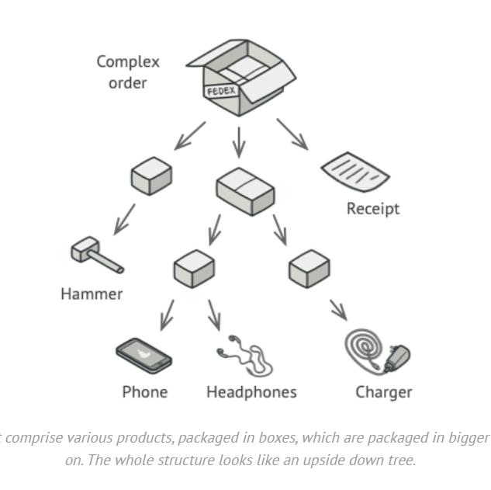
Problem
Using the Composite pattern makes sense only when the core model of your app can be represented as a tree.
For example, imagine that you have two types of objects: Products and Boxes.
A Box can contain several Products as well as several smaller Boxes. These little Boxes can also hold some Products or even smaller Boxes, and so on.
Say you decide to create an ordering system that uses these classes. Orders could contain simple products without any wrapping, as well as boxes stuffed with products...and other boxes. How would you determine the total price of such an order?

Slide 6
Problem
You could try the direct approach: unwrap all the boxes, go over all the products and then calculate the total.
That would be doable in the real world; but in a program, it’s not as simple as running a loop.
You must know the classes of Products and Boxes you’re going through, the nesting level of the boxes and other nasty details beforehand.
All of this makes the direct approach either too awkward or even impossible.

Slide 7
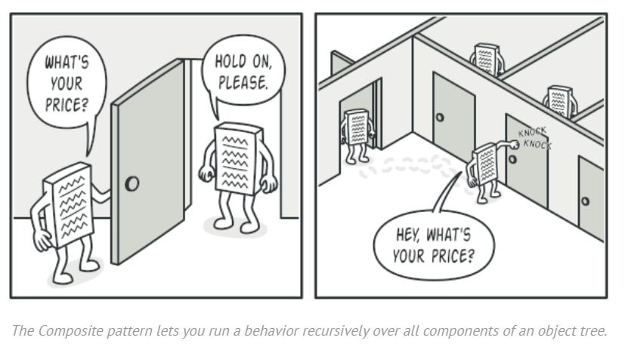
Solution
The Composite pattern suggests that you work with Products and Boxes through a common interface which declares a method for calculating the total price.
How would this method work?
For a product, it’d simply return the product’s price.
For a box, it’d go over each item the box contains, ask its price and then return a total for this box.
If one of these items were a smaller box, that box would also start going over its contents and so on, until the prices of all inner components were calculated.
A box could even add some extra cost to the final price, such as packaging cost.

Slide 8
Solution
The greatest benefit of this approach is that you don’t need to care about the concrete classes of objects that compose the tree.
You don’t need to know whether an object is a simple product or a sophisticated box.
You can treat them all the same via the common interface. When you call a method, the objects themselves pass the request down the tree.

Slide 9
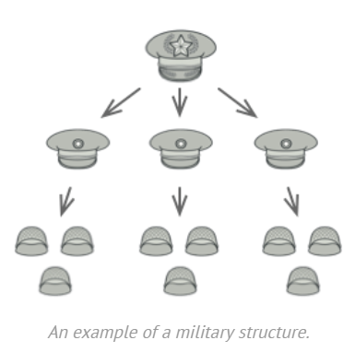
Real World Analogy
Armies of most countries are structured as hierarchies.
An army consists of several divisions; a division is a set of brigades, and a brigade consists of platoons, which can be broken down into squads.
Finally, a squad is a small group of real soldiers. Orders are given at the top of the hierarchy and passed down onto each level until every soldier knows what needs to be done.

Slide 10
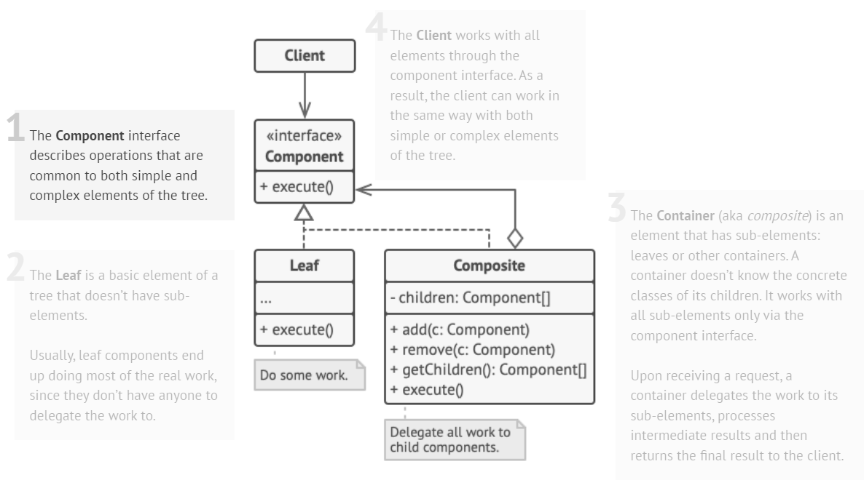
Structure

Slide 11
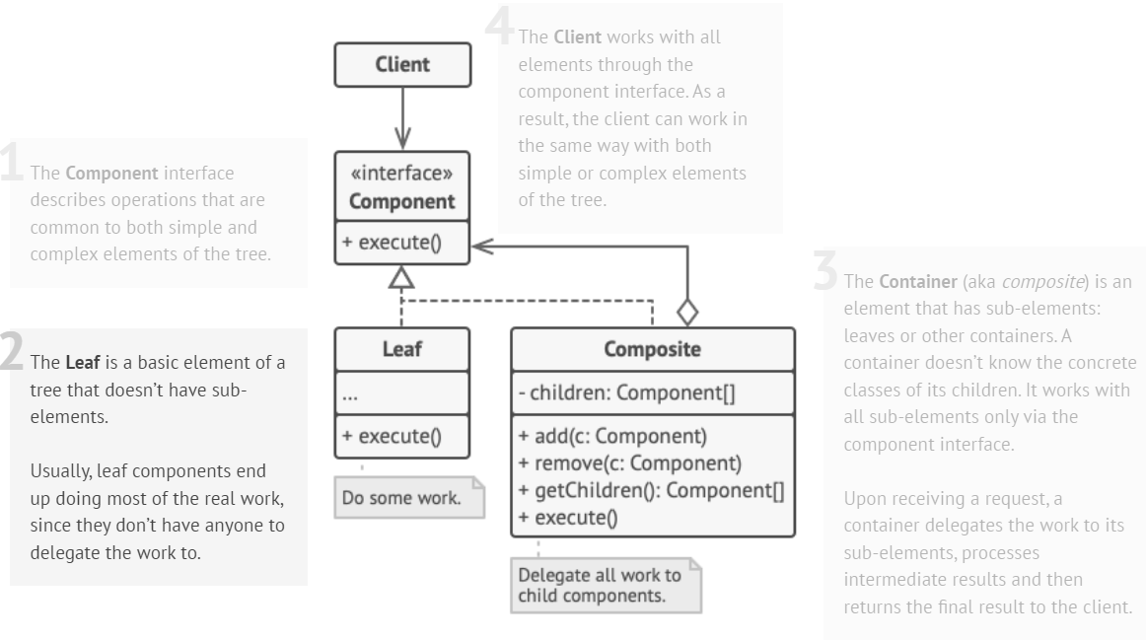
Structure

Slide 12
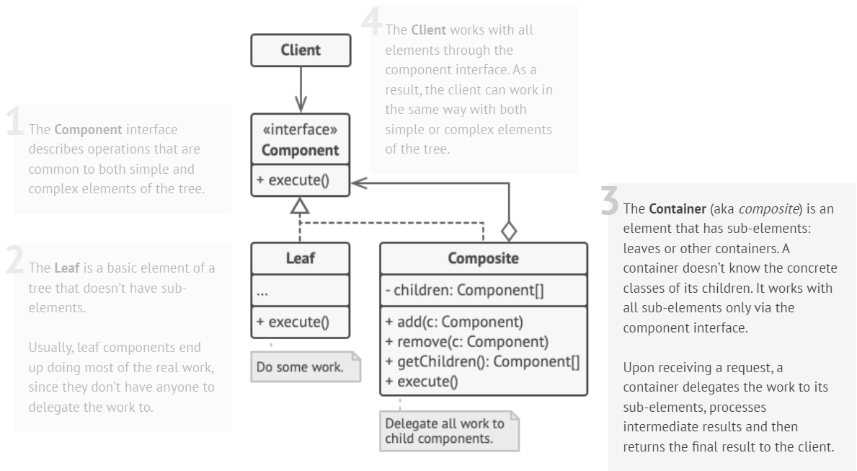
Structure

Slide 13
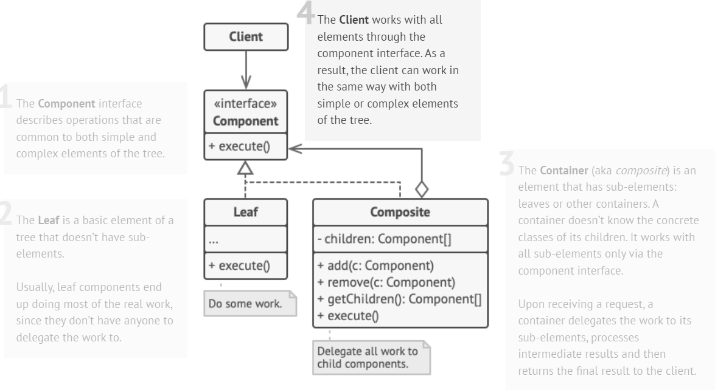
Structure

Slide 14
Example
// Component interface
class Item {
public:
virtual double getPrice() const = 0;
};
// Leaf class (Product)
class Product : public Item {
private:
double price;
public:
Product(double p) {
price = p;
}
double getPrice() const override {
return price;
}
};
// Composite class (Box)
class Box : public Item {
private:
vector<Item*> items;
public:
void add(Item* item) {
items.push_back(item);
}
double getPrice() const override {
double totalPrice = 0.0;
for (const auto& item : items) {
totalPrice += item->getPrice();
}
return totalPrice;
}
};

Slide 15
Example
int main() {
// Creating products
Item* product1 = new Product(20.0);
Item* product2 = new Product(30.0);
// Creating boxes
Box box1;
Box box2;
// Adding products to boxes
box1.add(product1);
box2.add(product2);
// Adding boxes to another box
Box mainBox;
mainBox.add(&box1);
mainBox.add(&box2);
// Calculating total price of the main box
double totalPrice = mainBox.getPrice();
cout << "Total Price of the main box: " << totalPrice << endl;
}
Output:
Total Price of the main box: 50

Slide 16
Adapter Pattern

Slide 17
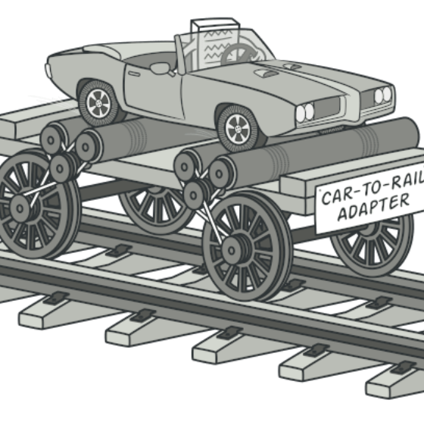
Adapter Design Pattern
Also Known as: Wrapper
Intent:
Adapter is a structural design pattern that allows objects with incompatible interfaces to collaborate.

Slide 18
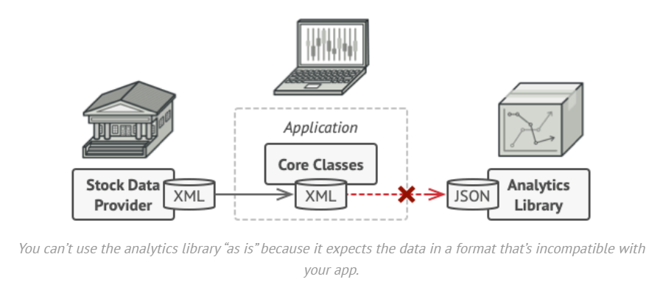
Problem
Imagine that you’re creating a stock market monitoring app. The app downloads the stock data from multiple sources in XML format and then displays nice-looking charts and diagrams for the user.
At some point, you decide to improve the app by integrating a smart 3rd-party analytics library. But there’s a catch: the analytics library only works with data in JSON format.
You could change the library to work with XML. However, this might break some existing code that relies on the library. And worse, you might not have access to the library’s source code in the first place, making this approach impossible.

Slide 19
Solution
You can create an adapter. This is a special object that converts the interface of one object so that another object can understand it.
An adapter wraps one of the objects to hide the complexity of conversion happening behind the scenes.
The wrapped object isn’t even aware of the adapter.
For example, you can wrap an object that operates in meters and kilometers with an adapter that converts all the data to imperial units such as feet and miles.

Slide 20
Solution
Adapters can not only convert data into various formats but can also help objects with different interfaces collaborate.
Here’s how it works:
The adapter gets an interface, compatible with one of the existing objects.
Using this interface, the existing object can safely call the adapter’s methods.
Upon receiving a call, the adapter passes the request to the second object, but in a format and order that the second object expects.
Sometimes it’s even possible to create a two-way adapter that can convert the calls in both directions.

Slide 21
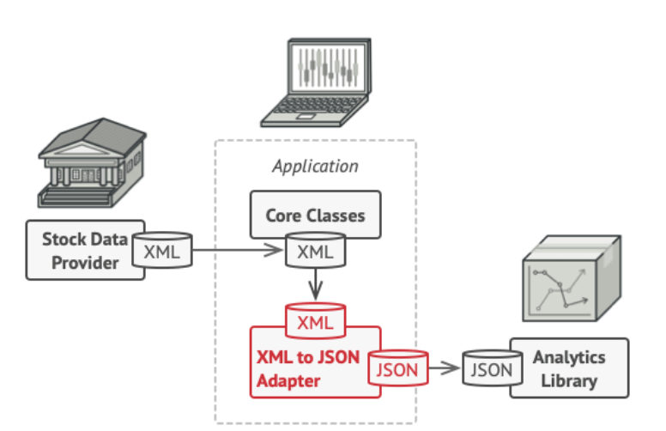
Solution
To solve the dilemma of incompatible formats, you can create XML-to-JSON adapters for every class of the analytics library that your code works with directly.
Then you adjust your code to communicate with the library only via these adapters.
When an adapter receives a call, it translates the incoming XML data into a JSON structure and passes the call to the appropriate methods of a wrapped analytics object.

Slide 22
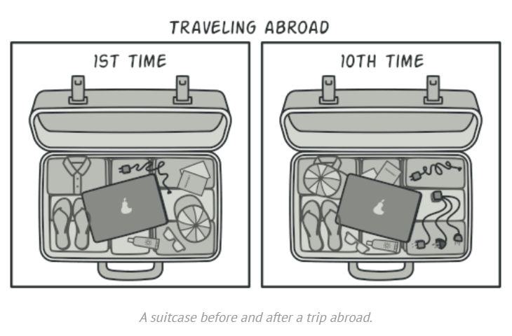
Real World Analogy
When you travel from the US to Europe for the first time, you may get a surprise when trying to charge your laptop. The power plug and sockets standards are different in different countries. That’s why your US plug won’t fit a German socket. The problem can be solved by using a power plug adapter that has the American-style socket and the European-style plug.

Slide 23
Structure (Object Adapter)
This implementation uses the object composition principle:
Adapter implements the interface of one object and wraps the other one. It can be implemented in all popular programming languages.

Slide 24
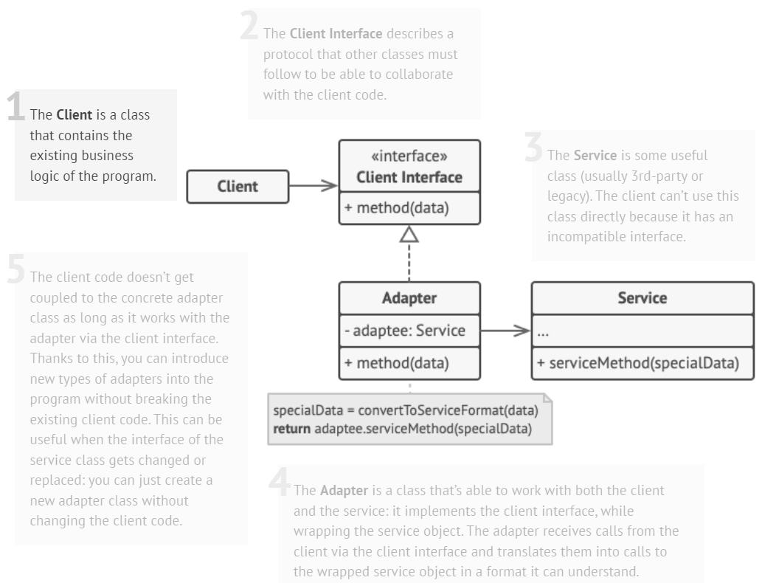
Structure (Object Adapter)

Slide 25
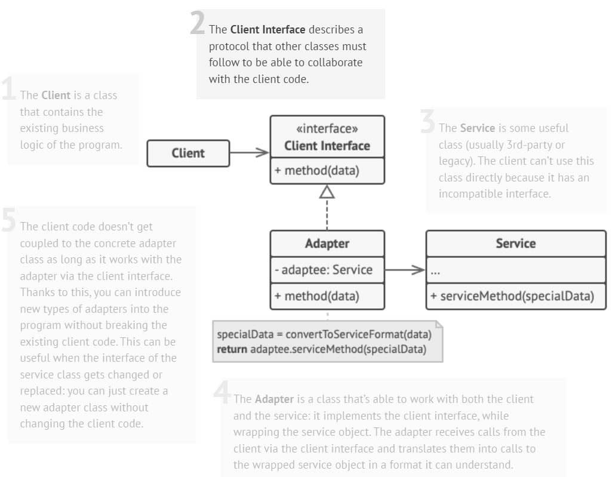
Structure (Object Adapter)

Slide 26
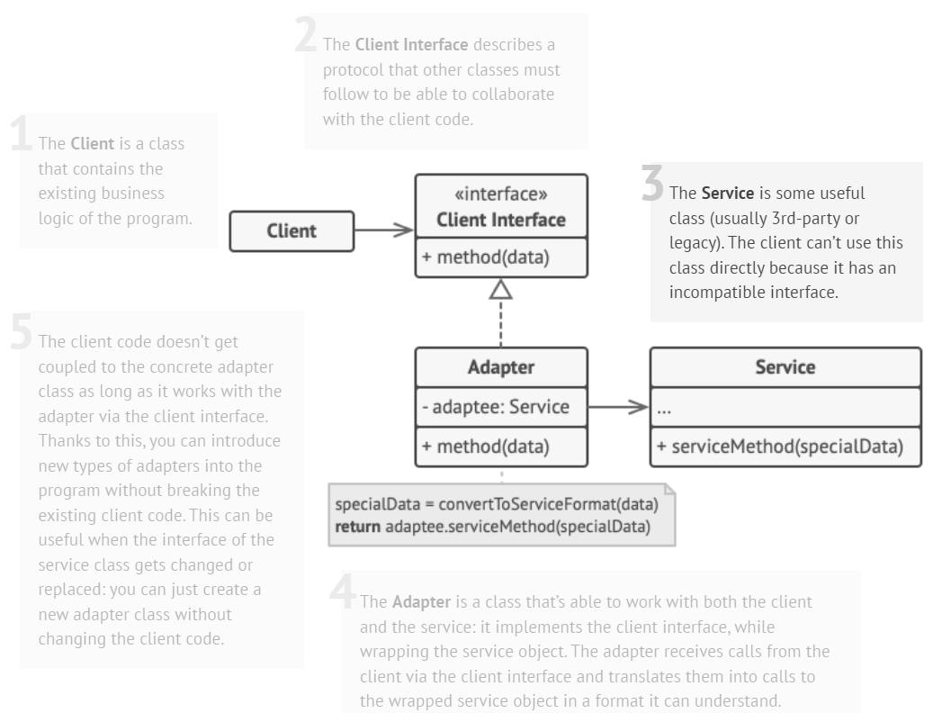
Structure (Object Adapter)

Slide 27
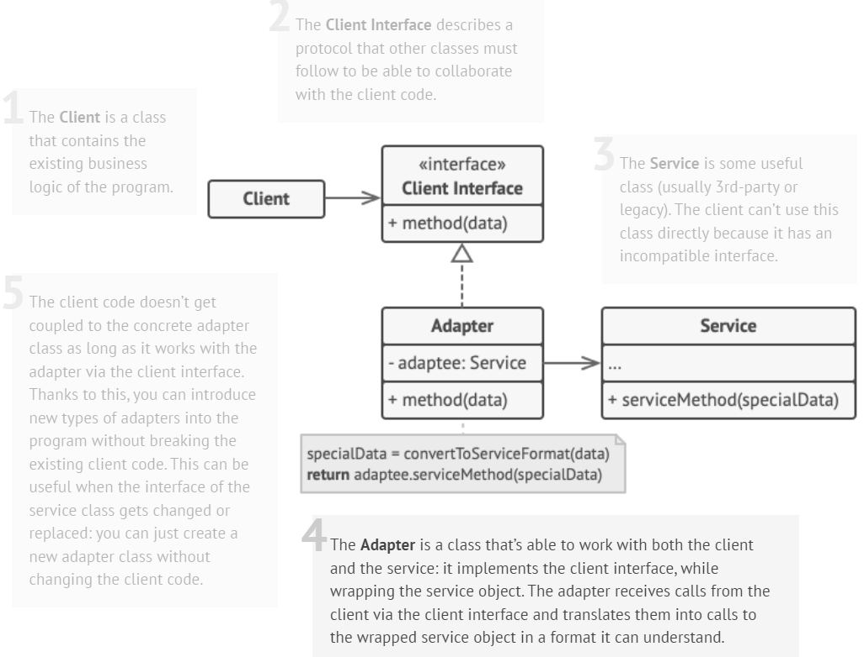
Structure (Object Adapter)

Slide 28
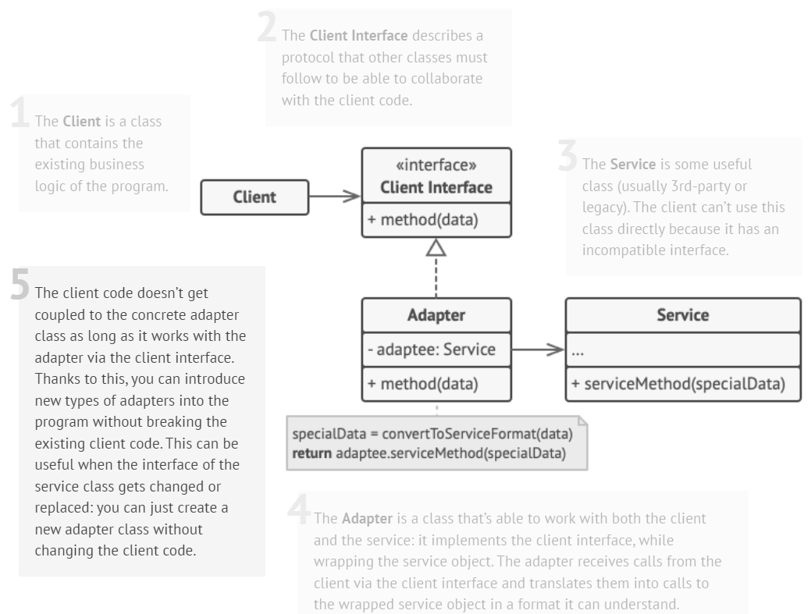
Structure (Object Adapter)

Slide 29
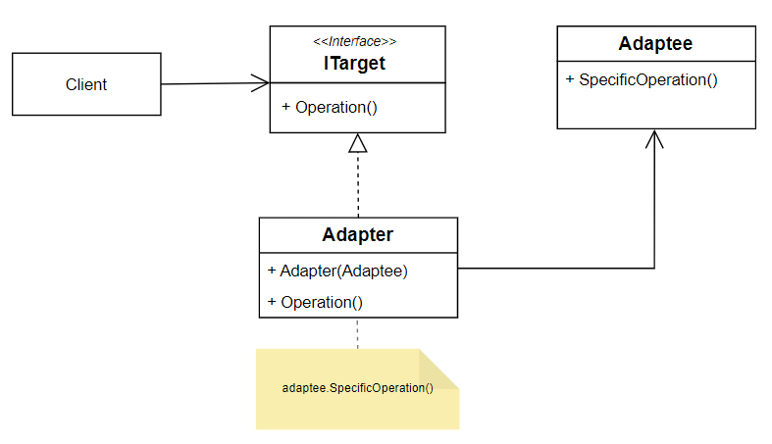
Example (Object Adapter)

Slide 30
Example (Object Adapter)
// Target: Desired interface our client expects
class Target {
public:
virtual void request() = 0;
};
// Adapter: Adapts the Adaptee's interface to the Target interface
class Adapter : public Target {
private:
Adaptee* adaptee;
public:
Adapter(Adaptee* a) {
adaptee = a;
}
void request() override {
// Using Adaptee's specificRequest within the Target's request
adaptee->specificRequest();
}
};
// Adaptee: Existing class with an incompatible interface
class Adaptee {
public:
void specificRequest() {
cout << "Adaptee's specificRequest called" << endl;
}
};
// Client code
int main() {
Adaptee* adaptee = new Adaptee();
Target* adapter = new Adapter(adaptee);
// Client uses the Target interface to call the Adaptee's method
adapter->request();
}
Output:
Adaptee's specificRequest called

Slide 31
Another Example (Object Adapter)
// Target: Represents a universal voltage interface
class Device220V {
public:
virtual void operateAt220V() = 0;
};
// Adapter: Adapts Device110V to operate at 220V
class VoltageAdapter : public Device220V {
private:
Device110V* device;
public:
VoltageAdapter(Device110V* d) {
device = d;
}
void operateAt220V() override {
// Using the Device110V's method within the Device220V's interface
cout << "Adapter converting 220V to 110V." << endl;
device->operateAt110V();
}
};
// Adaptee: Represents a device designed for 110V
class Device110V {
public:
void operateAt110V() {
cout << "Operating at 110V" << endl;
}
};
// Client code
int main() {
Device110V* device110V = new Device110V();
Device220V* adapter = new VoltageAdapter(device110V);
adapter->operateAt220V();
}
Output:
Adapter converting 220V to 110V.
Operating at 110V

Slide 32
Structure (Class Adapter)
This implementation uses inheritance:
Adapter inherits interfaces from both objects at the same time.
This approach can only be implemented in programming languages that support multiple inheritance, such as C++.

Slide 33
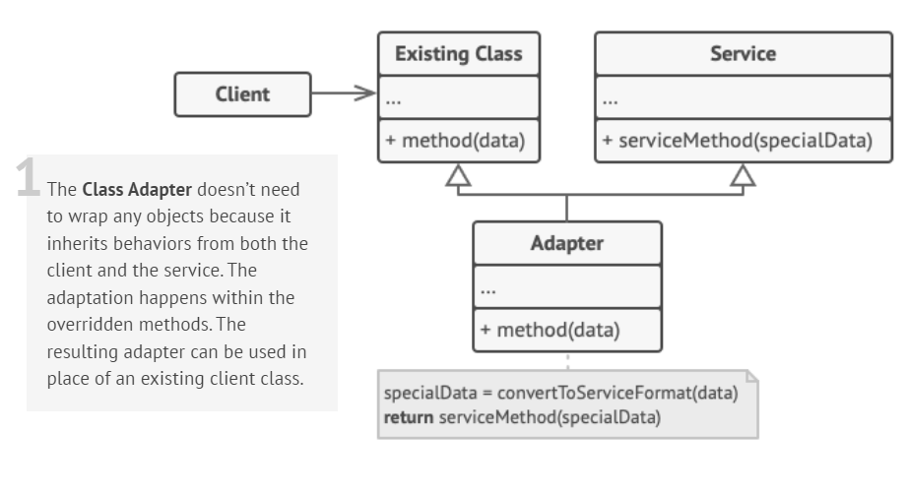
Structure (Class Adapter)

Slide 34
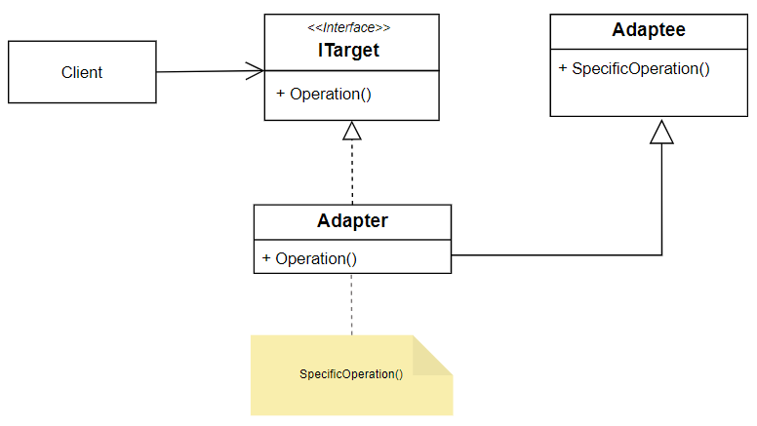
Example (Class Adapter)

Slide 35
Example (Class Adapter)
// Adaptee: Existing class with an incompatible interface
class Adaptee {
public:
void specificRequest() {
cout << "Adaptee's specificRequest called" << endl;
}
};
// Target: Desired interface our client expects
class Target {
public:
virtual void request() = 0;
};
// Adapter: Adapts the Adaptee's interface to the Target interface
class Adapter : public Target, private Adaptee {
public:
void request() override {
// Using Adaptee's specificRequest within the Target's request
specificRequest();
}
};
// Client code
int main() {
Target* adapter = new Adapter();
// Client uses the Target interface to call the Adaptee's method
adapter->request();
}
Output:
Adaptee's specificRequest called

Slide 36
Class Adapter Pattern
Implementation:
In the Class Adapter pattern, adaptation is achieved through class inheritance.
The adapter class extends both the target interface (the desired interface the client uses) and the adaptee class (the class with an incompatible interface).
Inheritance:
The adapter class inherits from the adaptee class, allowing it to reuse the adaptee's functionalities, and also implements the target interface, enabling the client to interact with the adapter through the target interface directly.
Pros and Cons:
Pros: Simpler structure, as it uses inheritance to adapt the interfaces.
Cons: It's inflexible when dealing with multiple inheritance limitations (e.g., in languages that don't support multiple inheritance, like Java).

Slide 37
Object Adapter Pattern
Implementation:
In the Object Adapter pattern, adaptation is achieved through composition.
The adapter contains an instance of the adaptee class, allowing it to delegate the calls from the target interface to the adaptee.
Composition:
The adapter class holds an instance of the adaptee class as a member variable.
It then implements the target interface by redirecting calls to the adaptee instance it contains.
Pros and Cons:
Pros: More flexible and versatile, as it doesn't rely on inheritance. It can adapt multiple adaptee classes by containing different instances.
Cons: Can result in more code due to the need for delegation methods and can be more complex to manage multiple instances.

Slide 38
References
Design Patterns: Elements of Reusable Object-Oriented Software, Erich Gamma, Richard Helm, Ralph Johnson, and John Vlissides, Pearson, 1995.
Helping Links:
https://refactoring.guru/design-patterns/
https://sourcemaking.com/design_patterns/
https://www.youtube.com/watch?v=Q1jZ4TI6MF4&t=297s&ab_channel=Telusko

